Slide 1
Oracle vs MySql
Hyukjoon Yang

Slide 2
Overview
Comparison of Oracle and MySQL
DBMS installation
Supporting functions
Storage support
Indexing
Security

Slide 3
Basic information
Comparison | Oracle | MySQL
Released date | 1980 | 1995
Licensed | Oracle corporation | GNU General Public License Purchased by Oracle
Scalability | Large scale deployments | Small and big businesses
Language | SQL | SQL and PL/SQL
System type | Static | Static and dynamic
XML | Does not support | Supports

Slide 4
DBMS Installation and Setup: Oracle
4 different versions of database installation
Enterprise edition
Provide all features
Standard edition
Provide basic features only
Express edition
Provide limited features but free
Oracle lite
Used for mobile devices
Operating system support
Windows, Max OS X, Linux, Unix, z/OS

Slide 5
DBMS Installation and Setup: MySQL
One version
MySQL Enterprise edition
Free and Full of features
Operating System support
Windows, Mac OS X, Linux, UNIX, z/OS
BSD, Symbian, AmigaOS

Slide 6
Support for built-in functions Stored Procedure
Oracle
Supports Stored procedure
Does not need to call delimiter $$
Catches exceptions in EXCEPTION clause
Can replace existing stored procedure
MySQL
Does not support Stored procedure
Needs to call delimiter
Does not catch exception
Cannot replace existing stored procedure
Drop and create new stored procedure

Slide 7
Major Data type comparison
Character
MySQL:
CHAR
VARCHAR
Oracle:
CHAR
VARCHAR2
NCHAR
NVARCHAR2
NULL value
MySQL
Supports NULL value
Oracle
Does not support NULL value

Slide 8
Support for Replication Comparison
Replication
A process that enables to have multiple copies of data automatically from superclass to subclass databases
Oracle
Oracle stream
Enables data replication and integration
Enables propagation of data and transactions
MySQL Replication
One-way asynchronous replication
MySQL Cluster
Shared-nothing clustering
Auto-partitioning
Synchronous

Slide 9
Storage support
Oracle
Supports data partitioning
Reduce cost for search
For very large-scale deployments
More storage features
Including storage features of MySQL
MySQL
Does not support data partitioning
For small and big businesses
More storage features
Tablespace, synonym, packages, etc.

Slide 10
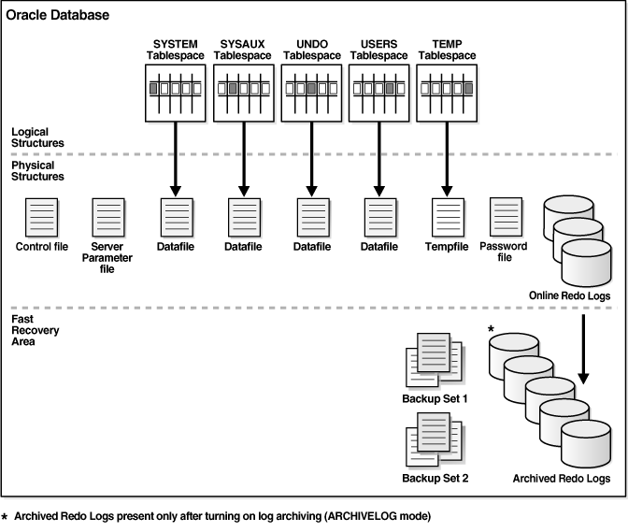
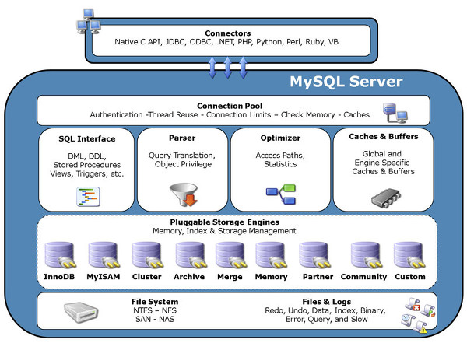
Storage support

Slide 11
Indexing
Oracle
Supports to create an index on
Columns of tables
Table, partitioned table, index-organized table, cluster
Scalar typed object attribute of a table
Nested table storage table for indexing a nested table column
Normal, Bitmap, Partitioned, Function-based, Domain, etc
MySQL
Primary key
Unique
Index
Hash index
Fulltext

Slide 12
Security
Oracle
Username
Password
Profile validation
Locking of data
Record (Row)
MySQL
Username
Password
Host
Locking of data
Page (Table)
Record only if indexing exists

Slide 13
Conclusion
MySQL is better for my Final Project
Free program
No need for professional features
Basic indexing provided by MySQL are enough
No need for big storage support
Size of data is not constantly updated
No need for enhanced security
Standalone program with no concurrent user
May be tedious work due to lack of built-in functions
Can overcome by investing more time

